Slide 1
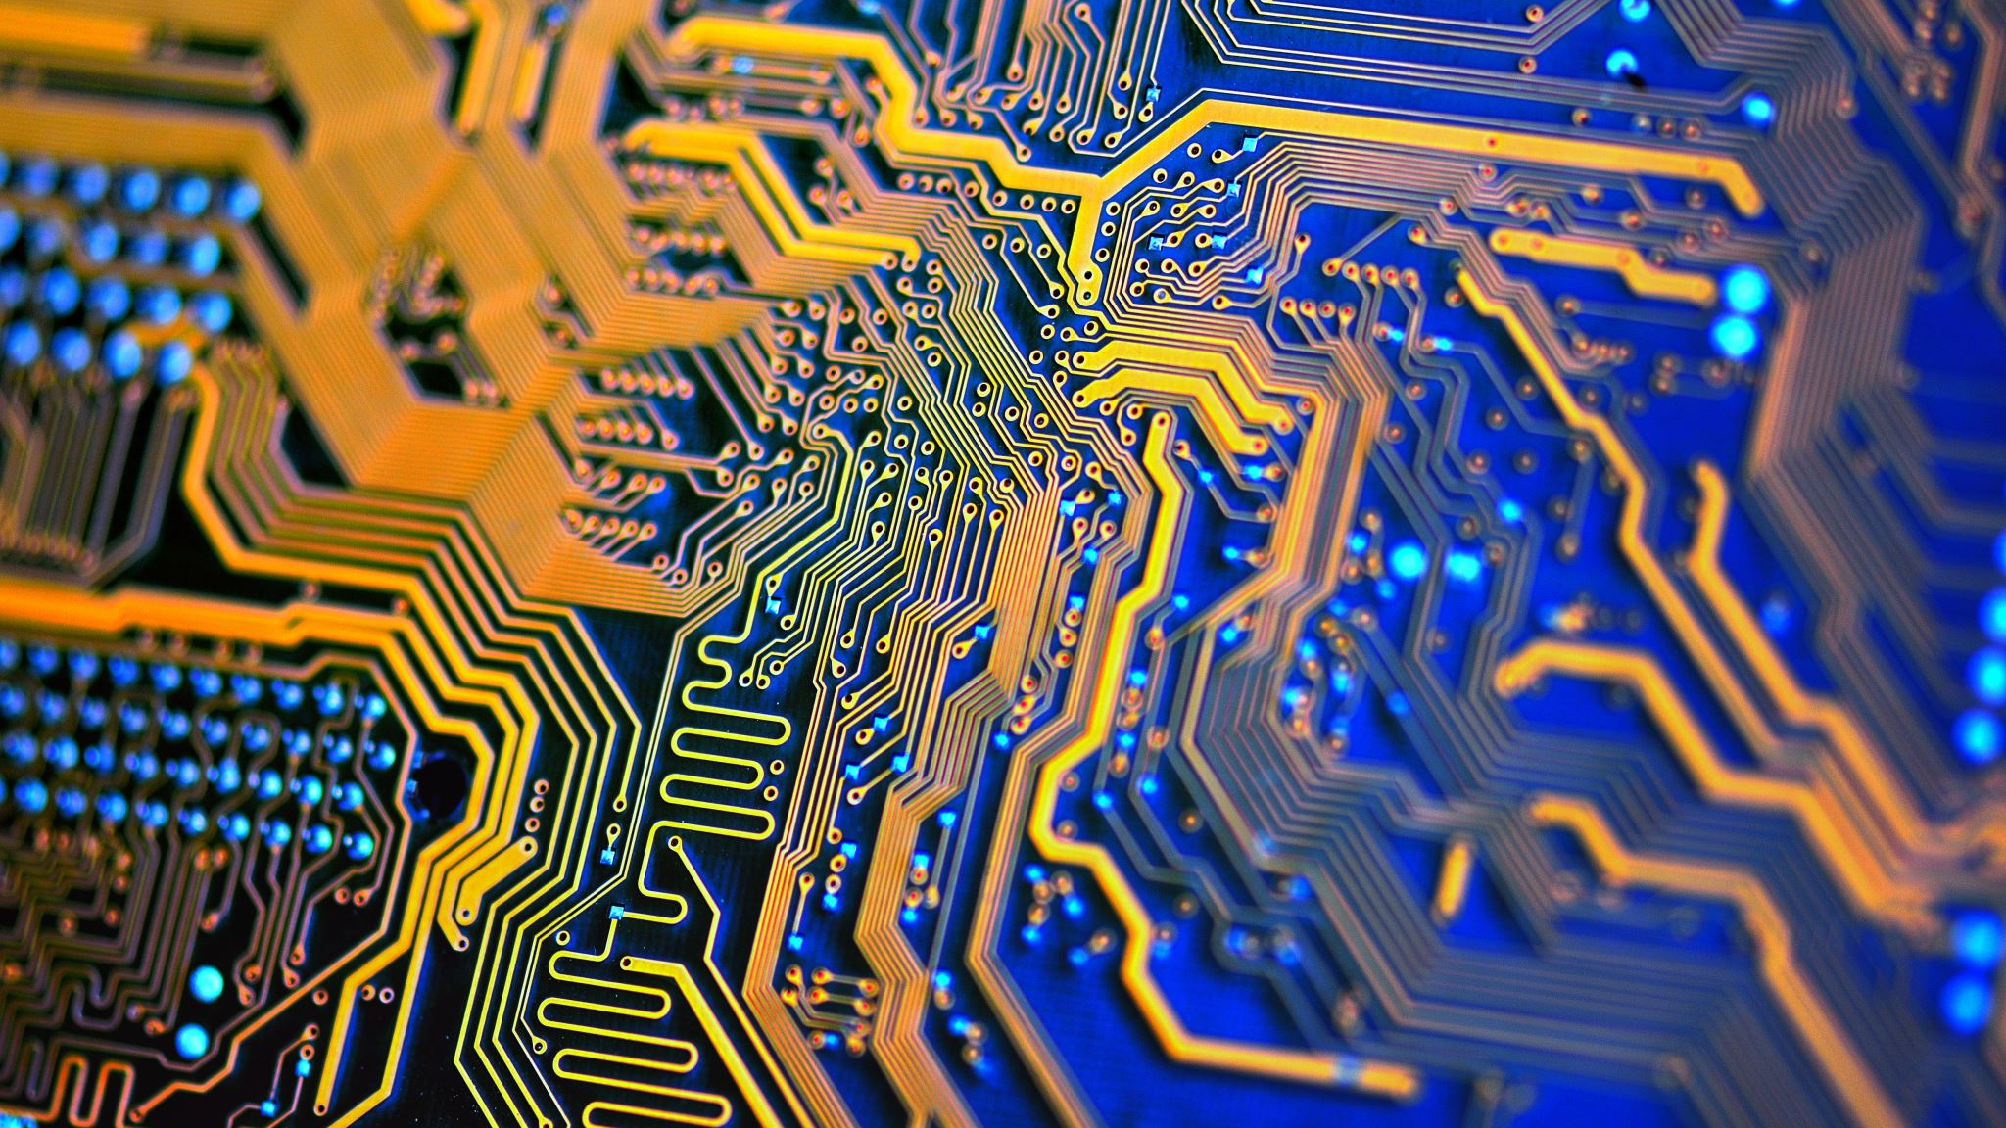
Art creation using AI
M.Zaki Al Akkari
K00233639@student.lit.ie

Slide 2
Why creating art using AI?
Art creation is very time demanding and requires huge effort from artist (months or years).
This will result in very expensive prices to own a piece of art.
Using Generative Adversarial Networks(GAN) would be a practical and cheaper alternative.
It would allow us to create art instantly on-demand and with much cheaper price.
Not much research on the performance of GANs for generating fine art.

Slide 3
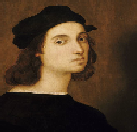
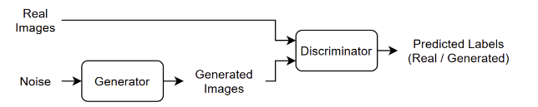
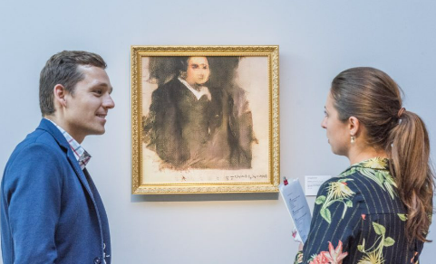
How can we generate art using AI?
We can achieve this using GAN
The GAN model will have two deep learning models: A generator and a discriminator.
The generator will generate images based on a latent noise space and the discriminator will discriminate between real images from the training dataset and fake images generated by the generator.
As the generator keeps monitoring the discriminator performance it will slowly but surely improve its performance in fooling the discriminator.

Slide 4
Challenges
Training GANs requires considerable time of computation and requires a good Graphic Processing Unit(GPU) to train the deep learning models specifically when dealing with large image size.
Fine-tuning the deep learning models and comparing the performance of different models also requires strategic thinking and good literature review.

Slide 5
Approach
Run literature review.
Choose appropriate art datasets.
Train and fine-tune the models.
Report results and finding.
Deploy the model in a more general context.

Slide 6
Bibliography
Kundu, Rohit. “AI-Generated Art: From Text to Images & beyond [Examples].” Www.v7labs.com, 25 Oct. 2022, www.v7labs.com/blog/ai-generated-art.
Rea, Naomi. “How Did A.I. Art Evolve? Here’s a 5,000-Year Timeline of Artists Employing Artificial Intelligence, from the Ancient Inca to Modern-Day GANs.” Artnet News, 16 Dec. 2021, news.artnet.com/art-world/artificial-intelligence-art-history-2045520.

Slide 7
Q/A

